Slide 1
Java + Hibernate ORM (Object Relational Mapping): Database Lab

Slide 2
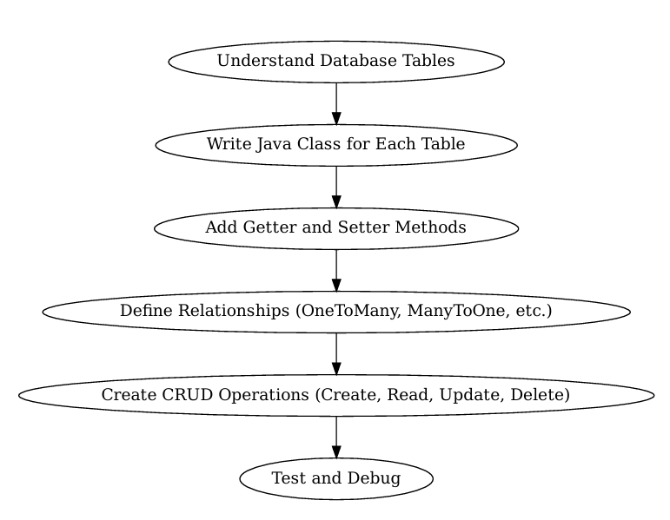

Slide 3



Use of Getters and Setters
JavaBean Standard
Getter Methods
Setter Methods
Follow established pattern for properties
getX() returns field value
setX() updates field value

Slide 4







Entity Relationships
@ManyToOne private Employee employee;
@OneToOne
@OneToMany
One-to-one relationship
One-to-many relationship
@ManyToMany
@ManyToOne
Many-to-many relationship
3
Many-to-one relationship

Slide 5
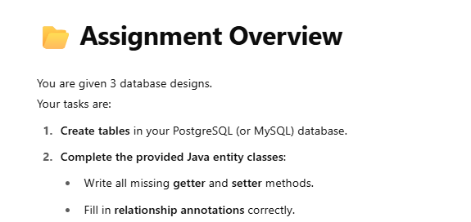
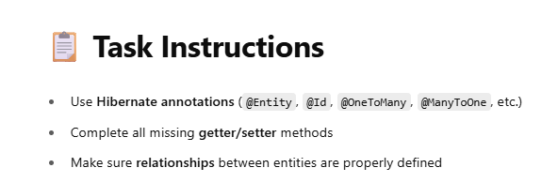
Java + Hibernate Assignment: Mastering Getter/Setter and Relationships

Slide 6
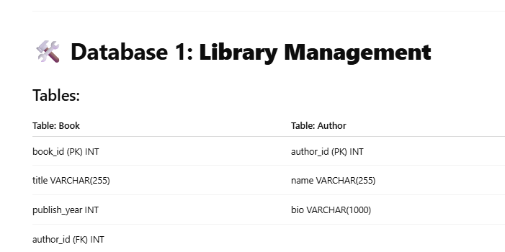

Slide 7
import jakarta.persistence.*;
import java.util.*;
@Entity
public class Author {
@Id
private int authorId;
private String name;
private String bio;
@________(mappedBy = "author", cascade = CascadeType.ALL)
private List<Book> books = new ArrayList<>();
// TODO: Complete all Getter and Setter methods here
}

Slide 8
import jakarta.persistence.*;
@Entity
public class Book {
@Id
private int bookId;
private String title;
private int publishYear;
____________
@JoinColumn(name = "author_id")
private Author author;
// TODO: Complete all Getter and Setter methods here
}

Slide 9
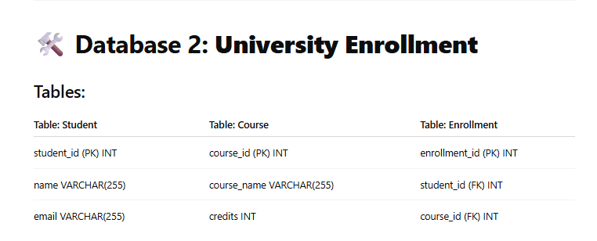

Slide 10
import jakarta.persistence.*;
import java.util.*;
@Entity
public class Course {
@Id
private int courseId;
private String courseName;
private int credits;
_____________(mappedBy = "course", cascade = CascadeType.ALL)
private List<Enrollment> enrollments = new ArrayList<>();
// TODO: Complete all Getter and Setter methods here
}

Slide 11
import jakarta.persistence.*;
import java.util.*;
@Entity
public class Student {
@Id
private int studentId;
private String name;
private String email;
_____________(mappedBy = "student", cascade = CascadeType.ALL)
private List<Enrollment> enrollments = new ArrayList<>();
// TODO: Complete all Getter and Setter methods here
}

Slide 12
import jakarta.persistence.*;
@Entity
public class Enrollment {
@Id
private int enrollmentId;
__________
@JoinColumn(name = "student_id")
private Student student;
__________
@JoinColumn(name = "course_id")
private Course course;
// TODO: Complete all Getter and Setter methods here
}

Slide 13
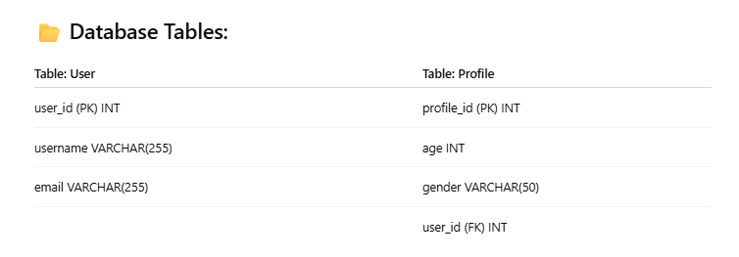

Slide 14
import jakarta.persistence.*;
@Entity
public class User {
@Id
private int userId;
private String username;
private String email;
___________(mappedBy = "user", cascade = CascadeType.ALL)
private Profile profile;
// TODO: Complete all Getter and Setter methods here
}

Slide 15
import jakarta.persistence.*;
@Entity
public class Profile {
@Id
private int profileId;
private int age;
private String gender;
___________
@JoinColumn(name = "user_id")
private User user;
// TODO: Complete all Getter and Setter methods here
}

